Slide 1

Text-A-HBAR:
Tokenized Stock Trade via Text
Presented by Ray Munene

Slide 2

CONTENTS
01
Opening & Problem
02
Solution & Product
03
Market & Vision
04
Technology & Impact
05
Roadmap & Demo

Slide 3


01
Opening & Problem

Slide 4
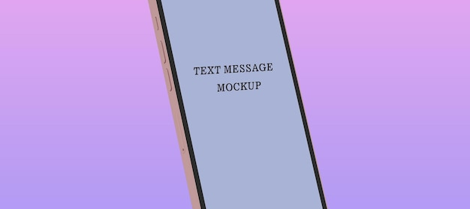
Text-A-HBAR
SMS Stock Exchange
The world’s first AI + SMS-powered tokenized stock exchange.
AI + SMS
Tokenized Assets
NSE Access

Slide 5
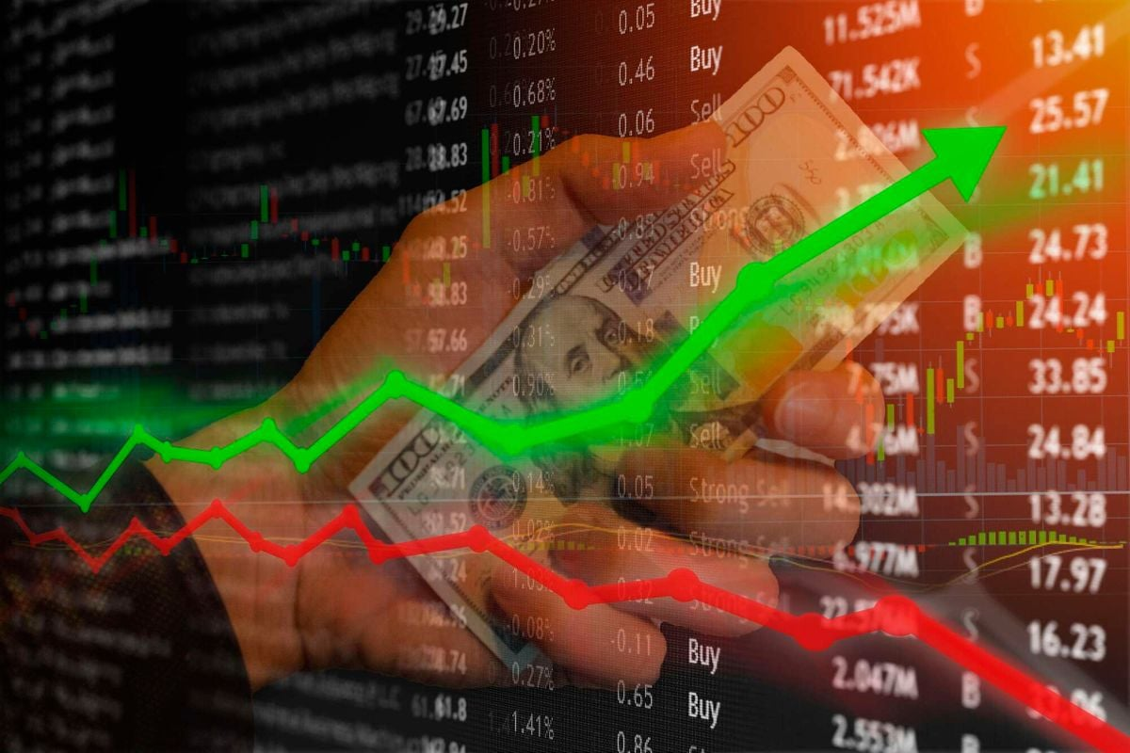
Investing Out of Reach for Millions
For millions in Africa, investing is still out of reach due to systemic barriers.
Barriers to Entry: Stock investing is limited to internet users with brokers.
Mobile-First Continent: 650M+ mobile users, but majority on feature phones.
Cost & Delay: High fees and slow settlement times hinder participation.
Complex Crypto Wallets: Require smartphones, data, and technical literacy.

Slide 6
02
Solution & Product

Slide 7
Tokenizing the NSE — One Text at a Time
A seamless, text-based workflow democratizes access to stock ownership.
1. User SMS
"Buy 3 Safaricom"
2. AI Chatbot
Processes Request
3. M-PESA
Payment Prompt
4. Hedera
Token Delivery
Powered by: 🤖 AI Chatbot | 💠 Hedera Hashgraph | 💬 SMS/USSD Interface

Slide 8

Real Stocks, Real Time, Real Tokens
Your stockbroker in a text conversation. Key features include:
AI-Powered Support Bot: Live NSE data via API.
Tokenized Assets: Each NSE company as a Hedera token.
Natural Language Commands: "price of safaricom", "buy 2 kcb".
SMS Payments: M-PESA simulation for accessibility.
Hedera Token Delivery: Instant transfer to your ID.

Slide 9
03
Market & Vision

Slide 10
Africa’s Mobile-First Token Exchange
A vast, untapped market awaits a solution that bridges the gap between mobile accessibility and financial markets.
$45B+
$200B+
400M+
Annual Remittances in SSA
East African Stock Volume
Potential Investors
Vision & Long-Term Potential
Expand to Uganda, Tanzania, Nigeria. Enable micro-investments and integrate Hedera-based stablecoins for seamless payouts.

Slide 11
04
Technology & Impact

Slide 12
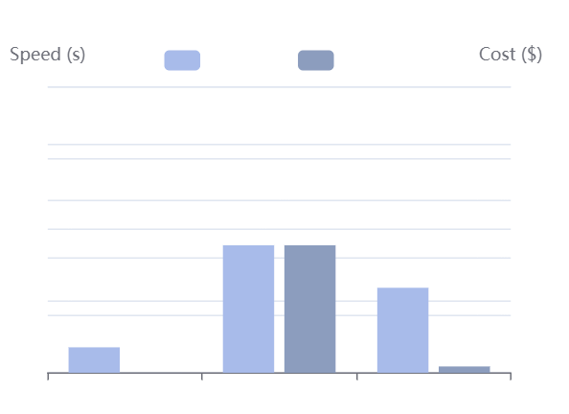
Why Hedera Delivers Inclusion
The perfect blockchain for financial inclusion, offering a unique combination of speed, cost, and sustainability.
Instant Finality: ~3 second transaction time.
Low Fees: Fraction-of-a-cent transaction costs.
Carbon-Negative: Environmentally sustainable consensus.
Enterprise Governance: Robust and reliable network.
Native Token Service (HTS): Ideal for fractional stock tokens.

Slide 13
Architecture: Bridging Finance & Web3
A layered architecture seamlessly connects traditional SMS infrastructure with modern blockchain technology.
SMS Gateway & User Interface
Flask Backend & Bedrock AI (Orchestration Layer)
M-PESA Simulation
Hedera SDK

Slide 14
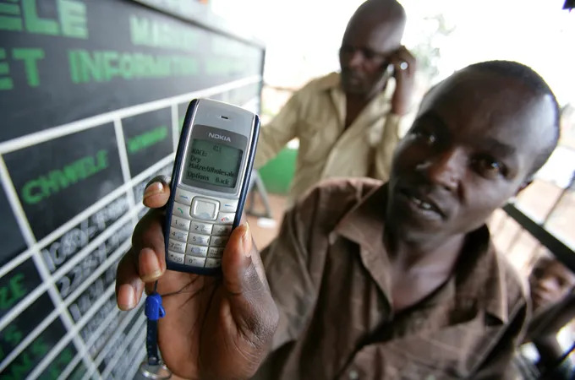
Socioeconomic Impact
Tokenizing opportunity for every phone, creating a ripple effect of financial empowerment.
Democratizes Investing: Opens access to millions previously excluded.
Enables Micro-Investments: Allows ownership of fractional shares.
Connects Economies: Links informal markets to global capital.
Promotes Green Finance: Built on Hedera's carbon-negative network.
"If you can send a text, you can now own a share of Safaricom."

Slide 15
05
Roadmap & Demo

Slide 16
The Ask
Roadmap to Mainnet
Join us in bringing Africa’s stock market to the blockchain.
1
Expand NSE token catalog (Top 20 companies)
Grant Funding: For SMS scaling, liquidity, and compliance.
Hedera Mentorship: For mainnet deployment & HTS optimization.
Partnerships: With NSE, mobile operators, and fintechs.
2
Add portfolio & analytics via AI bot
Use of Funds
3
Move from Testnet → Mainnet pilot
50%
30%
20%
Infra
Compliance
AI & Token Dev

Slide 17
Hackathon Integrity & Live Demo
Born in this hackathon. Built for real-world adoption.
Project Links
Demo Flow
GitHub Repo: Created after hackathon start.
Send "buy 3 saf" → Enter PIN → Receive tokens.
Live Demo: Available at [Render URL].
A full end-to-end test on Hedera Testnet.
Testnet Token ID:
0.0.7149494
Built Features
Hedera SDK Integration
Real-time Bedrock AI Chat
SMS/USSD Flow with M-PESA Sim
Tokenized NSE Assets

Slide 18
Thank You
Investing made as simple as a text message.

Slide 19

THANK YOU
Ray Munene

